Slide 1
Matthew Livingston
Ady (Ye Thiha Aung)
Yvan Burrie
Anthony Vincin
Stephen Ohl
Team 10

Slide 2
Introduction
Let us cover our workflow.
Let us reflect on what we did.
Let us suggest any improvements.
Notes:
The purpose of this presentation is to not only cover our workflow in the construction of our website but to also reflect upon what we did and to also suggest what we could have done to improve everything.

Slide 3


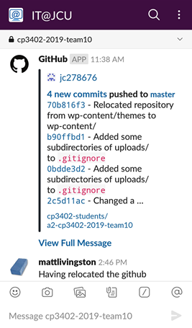

Communication
Slack
Github
Slack’s Github app
Meetings
Notes:
Slack and Github integration.

Slide 4

Collaboration

Slide 5
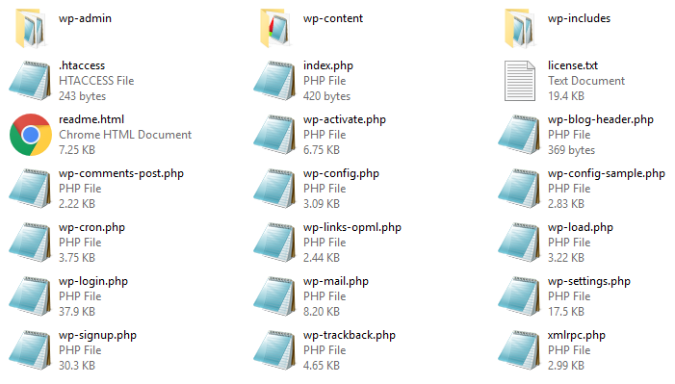
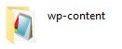

Repo Folder Layout

Slide 6







Technologies & Services

Slide 7

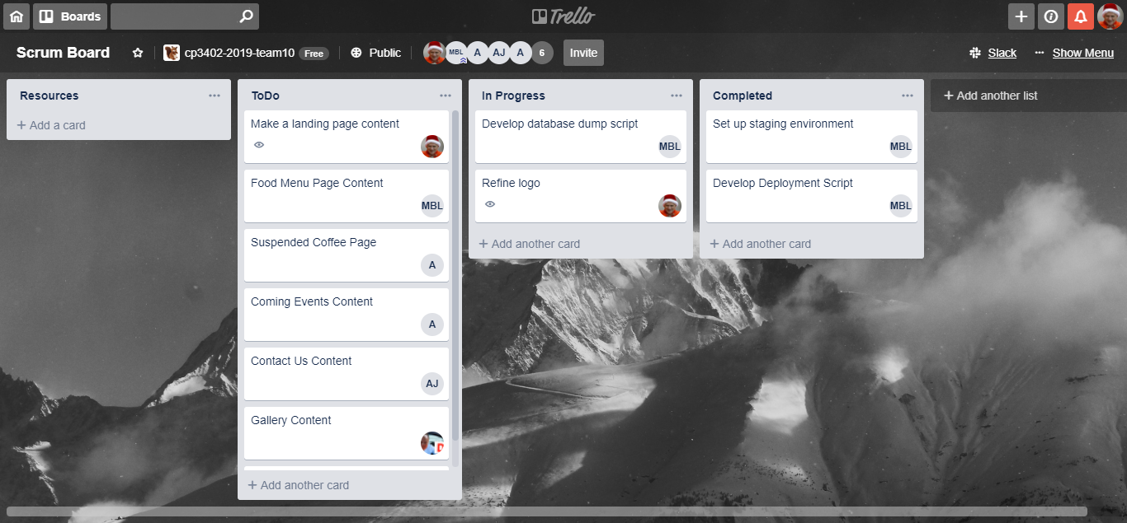
Project Management
(old method)
Notes:
Trello was a single Kanban project board.
Trello was too distant to our communication and collaboration means.

Slide 8
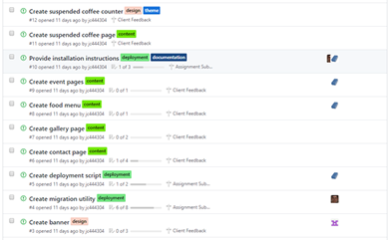
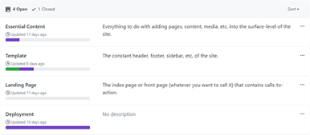
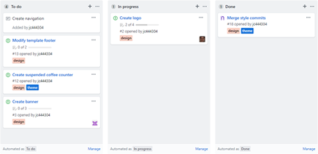
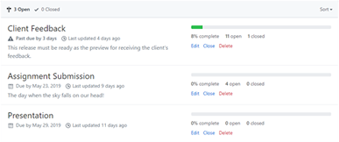
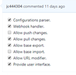
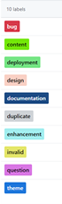
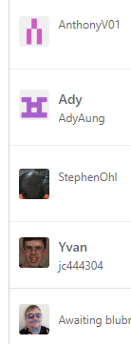
Project Management
(new method)
Issues
Projects
Kanban + Cards
Milestones
Labels
Assignees

Slide 9


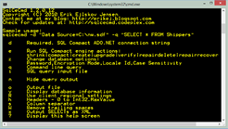

Database Migration
(old method)
Interface (2)
SQL
Dump
File
Import or Export
Interface (1)
Import or Export
Notes:
Our initial means of exchanging databases.
We needed to manually export and import SQL files using PhpMyAdmin (or MySQL commands).
This method was unsystematic and timely.

Slide 10

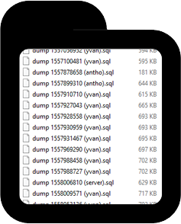
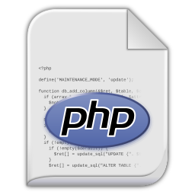
Database Migration
(new strategy)
Notes:
We instead used a PHP utility that handles database importation or exportion.

Slide 11

Database Migration
(after-thoughts)
Problem?
SQL dump file is a monolithic approach that can disrupt data integrity since .
Solution?
Use rollback approach such as version-controlled queries.

Slide 12

Deployment

Slide 13
Security

Slide 14

Any Questions ???

